Slide 1

Marketing Research Fall XXXX
Group X

Slide 2
Background
Owner & team contact: Eric Pherigo
Opened in April 2007
Located in downtown Columbia
Sells discounted college textbooks
Buys back used and unwanted textbooks
Stocks textbooks required for:
University of Missouri
Columbia College
Stephen’s College
Moberly Community College

Slide 3
Problem
How can The Textbook Game advertise more effectively to raise awareness and keep it top of mind throughout the semester?

Slide 4
Challenges
Not allowed to advertise on college campuses
Competitor of campus bookstores
Can’t send emails to student accounts
Advertising limited to Speaker’s Circle, Greek property, & around Columbia – Only Mizzou has Speaker’s Circle
Only 4 busy times of year
Purchasing: August/January
Selling: December/May
Students forget about The Textbook Game as option for purchasing over long breaks such as Winter/Summer break

Slide 5
Selection & Sample Info
Selection Factors
Sample
Criteria: Undergraduate college students in Columbia, Missouri
Colleges/Universities
University of Missouri
Columbia College
Stephen’s College
Moberly Community College
Sample Size = 108
Gender
Male = 45.37%
Females = 54.63%
Year in School
Freshmen = 26.85%
Sophomores = 19.44%
Juniors = 24.07%
Seniors = 29.63%

Slide 6
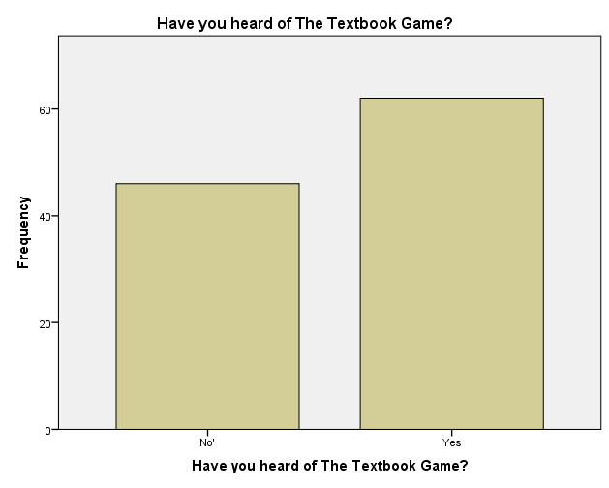
Have you heard of The Textbook Game?
57.4%
42.6%

Slide 7
 |  | What is your gender? |  | Total
 |  | Male | Female
Have you heard of The Textbook Game? | No | 25 | 21 | 46
 | Yes | 24 | 38 | 62
Total |  | 49 | 59 | 108
Variables are
not related
Variables are
not related
t = 2.606 Fail to Reject Ho
 |  | What level are you in school? |  |  |  | Total
 |  | Freshmen | Sophomore | Junior | Senior
Have you heard of The Textbook Game? | No | 26 | 10 | 4 | 6 | 46
 | Yes | 3 | 11 | 22 | 26 | 62
Total |  | 29 | 21 | 26 | 32 | 108
Variables
are related
t = 41.798*** Reject Ho
***Variables are significant at Confidence Intervals of 90%, 95%, 99%

Slide 8
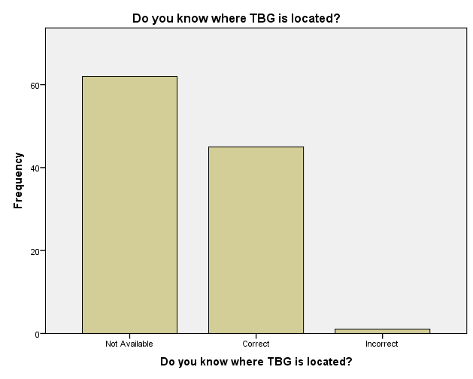
Do you know where The Textbook Game is located?
57.4%
41.7%
.9%

Slide 9
Variables
are related
 |  | What is your gender? |  | Total
 |  | Male | Female
Do you know where TBG is located? | Not Available | 37 | 25 | 62
 | Correct | 11 | 34 | 45
 | Incorrect | 1 | 0 | 1
Total |  | 49 | 59 | 108
t = 14.275 *** Reject Ho
Variables
are related
 |  | What level are you in school? |  |  |  | Total
 |  | Freshmen | Sophomore | Junior | Senior
Do you know where TBG is located? | Not Available | 27 | 12 | 12 | 11 | 62
 | Correct | 2 | 9 | 14 | 20 | 45
 | Incorrect | 0 | 0 | 0 | 1 | 1
Total |  | 29 | 21 | 26 | 32 | 108
t = 25.023*** Reject Ho
***Variables are significant at Confidence Intervals of 90%, 95%, 99%

Slide 10
 |  | Have you heard of The Textbook Game? |  | Total
 |  | No | Yes
Do you know where TBG is located? | Not Available | 46 | 16 | 62
 | Correct | 0 | 45 | 45
 | Incorrect | 0 | 1 | 1
Total |  | 46 | 62 | 108
Variables
are related
t = 59.451*** Reject Ho
***Variables are significant at Confidence Intervals of 90%, 95%, 99%

Slide 11
Current Advertising
TV
Radio
Website
Social Media
The Ad Sheet
Gonga, i.e., gorilla playing the accordion in speakers circle

Slide 12
Which advertising techniques influence students purchasing behaviors the most?
 | Radio | TV | Social Media | Print Ads | Word of Mouth | Other
Exposed | 21.30% | 60.19% | 70.37% | 32.41% | 40.74% | 1.85%
Not Exposed | 78.70% | 39.81% | 29.63% | 67.59% | 59.26% | 98.15%

Slide 13
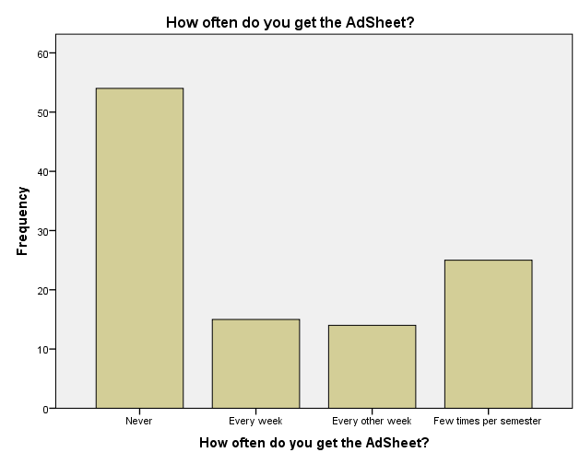
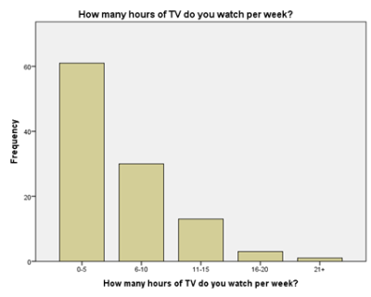
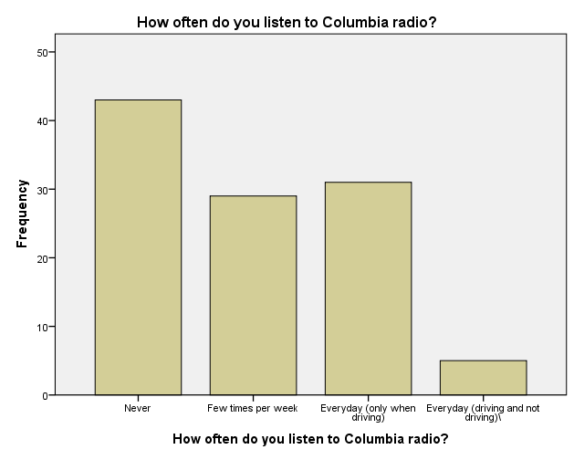
Comparison of Current Advertising

Slide 14
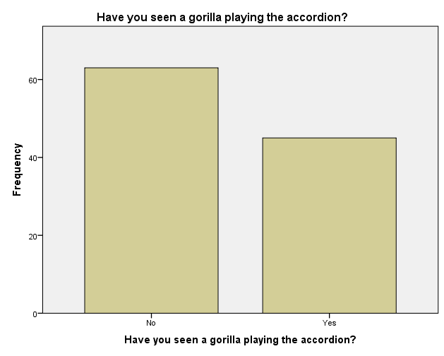
58.3%
41.7%

Slide 15
 |  | What level are you in school? |  |  |  | Total
 |  | Freshmen | Sophomore | Junior | Senior
Have you seen a gorilla playing the accordion? | No | 21 | 14 | 12 | 16 | 63
 | Yes | 8 | 7 | 14 | 16 | 45
Total |  | 29 | 21 | 26 | 32 | 108
Variables are
not related
t = 5.467 Fail to Reject Ho

Slide 16
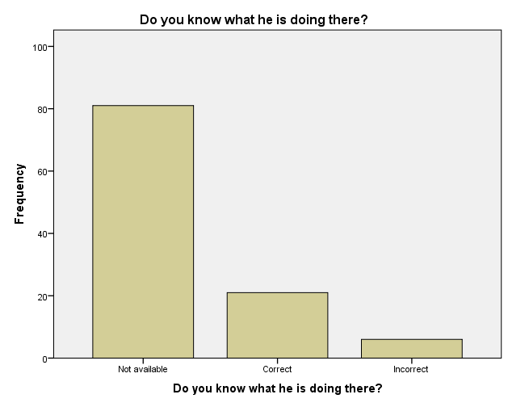
75%
19.4%
5.6%

Slide 17
 |  | Have you seen a gorilla playing the accordion? |  | Total
 |  | No | Yes
Have you heard of The Textbook Game? | No | 34 | 12 | 46
 | Yes | 29 | 33 | 62
Total |  | 63 | 45 | 108
Variables
are related
t = 8.002*** Reject Ho
***Variables are significant at Confidence Intervals of 90%, 95%, 99%

Slide 18
50%
23.1%
13.9%
13%

Slide 19
 |  | Have you heard of The Textbook Game? |  | Total
 |  | No | Yes
How often do you get The Ad Sheet? | Never | 31 | 23 | 54
 | Every week | 6 | 9 | 15
 | Every other week | 1 | 13 | 14
 | Few times per semester | 8 | 17 | 25
Total |  | 46 | 62 | 108
Variables
are related
t = 13.231*** Reject Ho
***Variables are significant at Confidence Intervals of 90%, 95%, 99%

Slide 20
 |  | Have you purchased any books from TBG? |  | Total
 |  | No | Yes
How often do you get The Ad Sheet? | Never | 53 | 1 | 54
 | Every week | 15 | 0 | 15
 | Every other week | 11 | 3 | 14
 | Few times per semester | 23 | 2 | 25
Total |  | 102 | 6 | 108
Variables
are related
t = 9.302** Reject Ho Fail to Reject Ho at 99%
 |  | Have you sold any books to TBG? |  | Total
 |  | No | Yes
How often do you get The Ad Sheet? | Never | 41 | 13 | 54
 | Every week | 11 | 4 | 15
 | Every other week | 6 | 8 | 14
 | Few times per semester | 13 | 12 | 25
Total |  | 71 | 37 | 108
Variables
are related
t = 8.222** Reject Ho Fail to Reject Ho at 99%
**Variables are significant at Confidence Intervals of 90% & 95%

Slide 21
Where do college students in Columbia, MO prefer to buy their textbooks?
Where did you purchase your textbooks this semester?
Campus Bookstore | 71 | 58.2%
Friends/ Other Students | 3 | 2.5%
The Textbook Game | 5 | 4.1%
Online | 42 | 34.4%
Other | 1 | .8%
Total | 122 | 100%
t = 158.32*** Reject Ho
***Variables are significant at Confidence Intervals of 90%, 95%, 99%

Slide 22
What motivates students to buy at campus bookstores rather than The Textbook Game?
 | Campus Bookstore | Friends/ Other Students | The Textbook Game | Online | Other | Total
Convenience | 57 | 2 | 3 | 22 | 0 | 84
Price | 11 | 3 | 2 | 26 | 1 | 43
Student Charge | 37 | 1 | 1 | 4 | 0 | 43
Easy to change/cancel | 6 | 1 | 1 | 2 | 0 | 10
Return Policy | 5 | 0 | 3 | 2 | 0 | 10
Other | 3 | 0 | 0 | 7 | 0 | 10
Total | 119 | 7 | 10 | 63 | 1 | 200
Variables
are related
t = 62.348*** Reject Ho – Variables are significant at Confidence Intervals of 90%, 95%, 99%

Slide 23
How do students pay for their books and how does this affect their purchase decisions?
 | You | Parents | Student Loans | Other | Total
Convenience | 23 | 49 | 11 | 3 | 86
Price | 18 | 21 | 2 | 1 | 42
Student Charge | 7 | 31 | 6 | 1 | 45
Easy to change/cancel | 5 | 6 | 1 | 0 | 12
Retrun Policy | 4 | 3 | 2 | 0 | 9
Other | 4 | 3 | 2 | 1 | 10
Total | 61 | 113 | 24 | 6 | 204
Variables are
not related
t = 17.012 Fail to Reject Ho

Slide 24
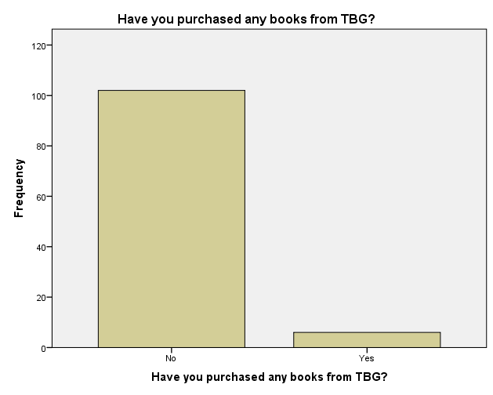
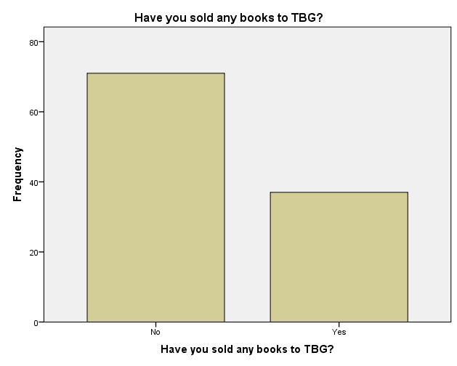
How many students: A) Buy books at The Textbook Game? B) Sell books back to The Textbook Game? C) Buy & sell back books at The Textbook Game?
A)
B)
94.4%
65.7%
34.3%
5.6%

Slide 25
How many students buy and sell at The Textbook Game?
C)
 |  | Have you sold any books to TBG?
 |  | No | Yes
Have you purchased any books from TBG? | No | 63.89% | 38.56%
 | Yes | 1.85% | 3.70%

Slide 26
 |  | What level are you in school? |  |  |  | Total
 |  | Freshmen | Sophomore | Junior | Senior
Have you purchased any books from TBG? | No | 29 | 20 | 24 | 29 | 102
 | Yes | 0 | 1 | 2 | 3 | 6
Total |  | 29 | 21 | 26 | 32 | 108
Variables are
not related
t = 2.847 Fail to Reject Ho
 |  | What level are you in school? |  |  |  | Total
 |  | Freshmen | Sophomore | Junior | Senior
Have you sold any books to TBG? | No | 29 | 14 | 8 | 20 | 71
 | Yes | 0 | 7 | 18 | 12 | 37
Total |  | 29 | 21 | 26 | 32 | 108
Variables
are related
t = 29.388 *** Reject Ho
***Variables are significant at Confidence Intervals of 90%, 95%, 99%

Slide 27
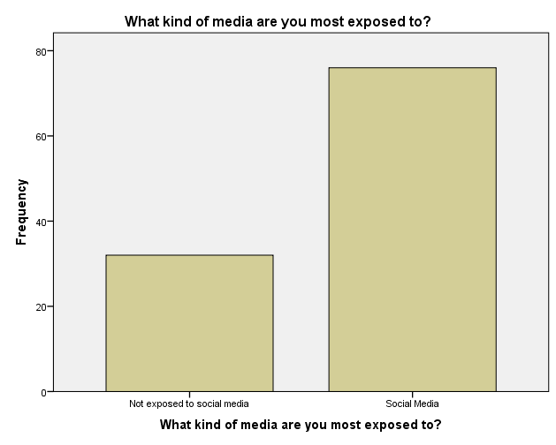
Social Media
70.4%
29.6%

Slide 28
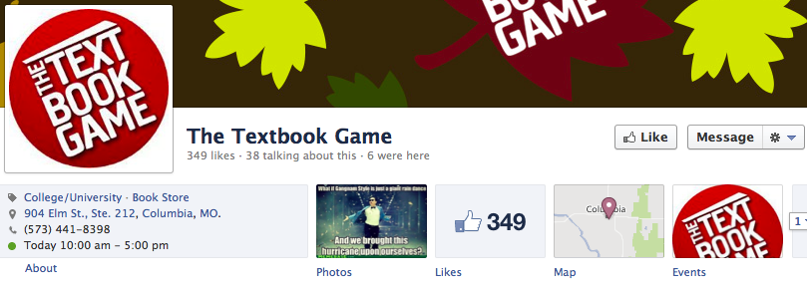
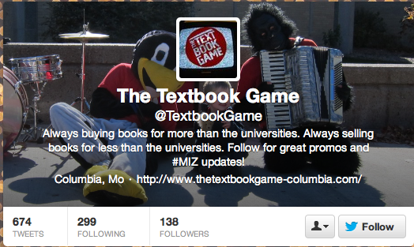

Slide 29
Social Media
Have all selling customers “like” and “follow” to help raise awareness
Free T-shirt if you “like” and “follow” - free student advertising
Raffle for students who newly “liked” and “followed”
Create a Facebook “check in” location
Offer incentive coupons on social media to encourage customers to buy
Use social media at beginning of semester to direct message and remind students about The Textbook Game’s services
Social media can help word of mouth advertising

Slide 30
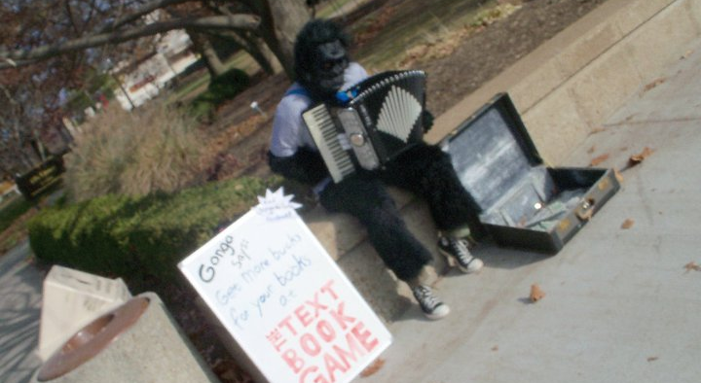
Gonga

Slide 31
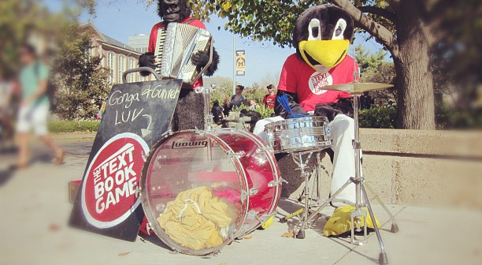
Gonga

Slide 32
Gonga Recommendations
Banner sign rather than chalkboard sign
Gonga assistant passes out flyers/coupons
Walk around downtown to increase exposure
19.4%

Slide 33
The Ad Sheet
Use The Add Sheet only to promote end of semester selling
Start advertising 1st week of November and April
Use social media to promote Ad Sheet coupons
Offer incentive coupon for purchasing books next semester
50%
50%

Slide 34
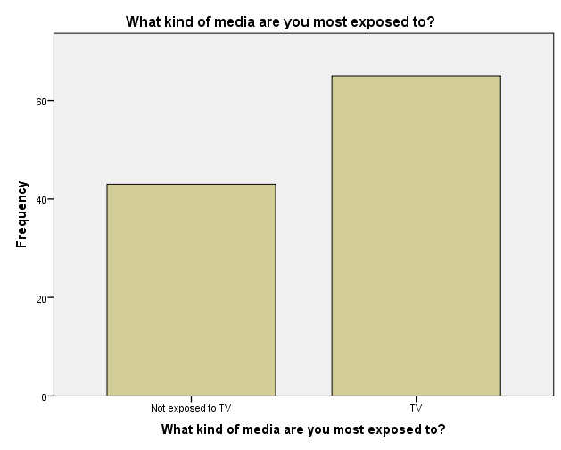
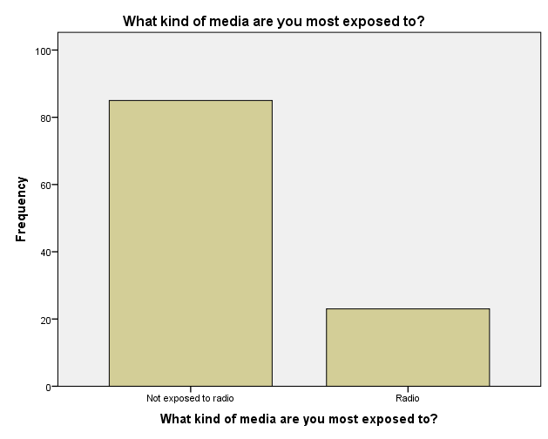
TV & Radio
60.19%
78.70%
39.81%
21.30%

Slide 35

TV & Radio
56.48%
39.81%
28.70%
26.85%
27.78%
12.04%
4.63%
2.78%
.92%
Don’t use TV or Radio

Slide 36
Limitations
Lack of research team experience
Too many broad problems, hard to choose just one
A lot of great research questions, but not sure EXACTLY what to look for
Some great ideas came after data collection was complete

Slide 37
Questions

Slide 38
Appendix A: Research Objectives
Determine which advertising technique influences students purchasing behaviors the most.
Develop an understanding of where college students in Columbia prefer to buy their textbooks.
Assess the awareness of The Textbook Game’s in-store and online options among college students in Columbia.
Determine what kind of experience or offer students would be most likely to talk about with their friends.
Determine the reasons why students choose to go to the university bookstore rather than The Textbook Game
Understand how students pay for their books, and how that motivates their purchasing decisions (Parents, grandparents, loans, etc.)
Determine how many students: A) Buy books only at The Textbook Game, B) Only sell books back to The Textbook Game, C) Buy and sell back books at The Textbook Game

Slide 39
Appendix B: Research Questions
Most Important
What is the most effective way to keep The Textbook Game top of mind as an option for buying textbooks over long breaks such as summer and winter break?
What can be done to ensure that students, who sell their books back to The Textbook Game, also purchase their books there at the beginning of the next semester?
Are the same types of advertising at Mizzou, Columbia College, Stephens College, and Moberly Community College equally effective at all colleges? – differences research question
What percentage of students a) Buy books only at The Textbook Game, B) Only sell books back to The Textbook Game, C) Buy and sell back books at The Textbook Game?

Slide 40
Appendix B: Research Questions
Moderately Important
What motivates students to buy at the University Bookstore rather than The Textbook Game?
What additions or changes could be made to the current marketing plan to raise awareness about The Textbook Game and the benefits it has to offer?
How could The Textbook Game target students and their parents before coming to Columbia?

Slide 41
Appendix B: Research Questions
Least Important
How can The Textbook Game show students that they offer more benefits than purchasing books at the bookstore?
How do most college students pay for their books? (Parents, grandparents, loans, etc.)

Slide 42
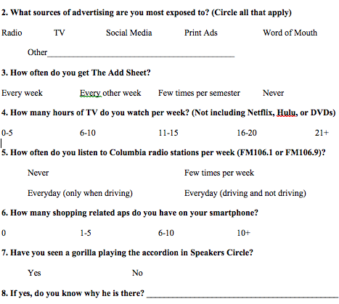
Appendix C: Questionnaire

Slide 43
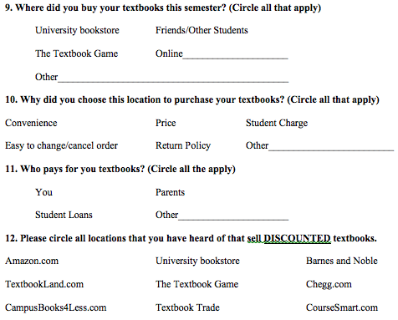
Appendix C: Questionnaire

Slide 44
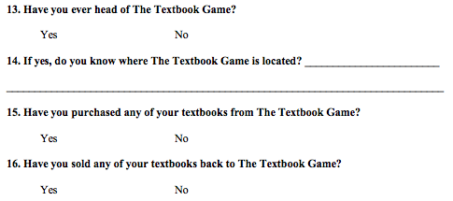
Appendix C: Questionnaire

Slide 45
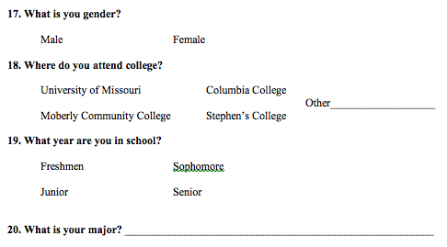
Appendix C: Questionnaire

